Slide 1

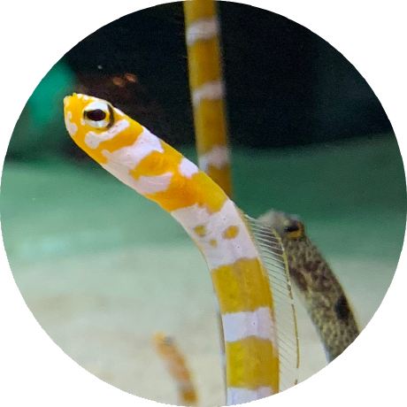
https://www.klayout.de/forum/discussion/2043/build-klayout-inside-conda-environment
Initially posted by Grandement (2022-03-04)
Build KLayout Inside Conda Environment
Aim:
To organize my brain, which is starting to get cluttered
By Kazzz-S (2023-01-30)

Slide 2
1. Different Build Scenarios Tested with KLayout 0.28.3
Scenario | Mac-B | Mac-H | Mac-P | Mac-A | Mint19-A | Mint19-B | Mint19-C
Anaconda3 installer | n/a |  | n/a | Anaconda3-2022.10-MacOSX-x86_64.pkg | Anaconda3-2021.11-Linux-x86_64.sh | Anaconda3- 2022.10-Linux- x86_64.sh | Anaconda3- 2022.10-Linux- x86_64.sh
Qt5 | Homebrew 5.15.8 | Homebrew 5.15.8 | MacPorts 5.15.8 | Anaconda3 5.15.2 | Anaconda3 5.9.7 | Anaconda3 5.15.2 | Anaconda3 5.15.2
Python3 | Homebrew 3.9.16 | Homebrew 3.9.16 | MacPorts 3.9.16 | Anaconda3 3.9.16 | Anaconda3 3.8.8 | Anaconda3 3.9.16 | Anaconda3 3.9.15
Ruby | Homebrew 3.1.3 | OS-bundled 2.6.10 | MacPorts 3.1.3 | Anaconda3 3.1.2 | Mint19 2.5.1 | Anaconda3 3.1.2 | Anaconda3 3.1.2
C++ compiler | Apple clang included in macOS-compliant Xcode |  |  |  | Mint19 g++ v7.5.0 |  | g++ 11.2.0 (Anaconda gcc)
libstdc++ | macOS-bundled v6.0.9 |  |  | 1.0.0 | Mint19 v6.0.26 | Mint19 v6.0.26 Anaconda3 v6.0.29 | Anaconda3 v6.0.29
libGL et al | macOS-bundled OpenGL v1.0.0 |  |  |  | Mint19 libgl1 v1.0.0
details | https://github.com/KLayout/klayout/issues/1250 |  |  |  | A | B | C
build status | success |  |  |  | success | success | success
remarks | published 16(=4x4) DMGs on 2023-01-16 https://www.klayout.de/build.html#downloads |  |  |  | refer to the details

Slide 3
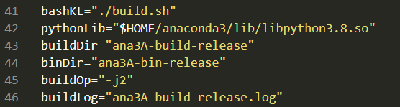
2. Details of Scenario=Mint19-A
Pros | Well fit to the base Linux system (Mint 19.3 Tricia) with minimal preparations
Cons | Anaconda3’s Python and OS-bundled Ruby are not up to date Qt5 version is a little bit obsolete
Key Parameters
Command Line
Detailed Steps and Wrapper Bash

Slide 4
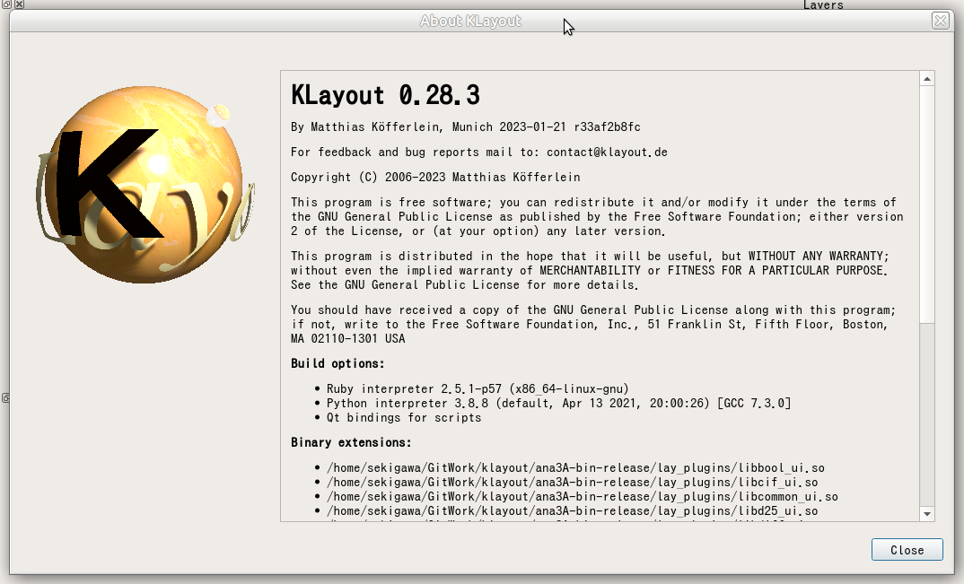
2. Details of Scenario=Mint19-A

Slide 5
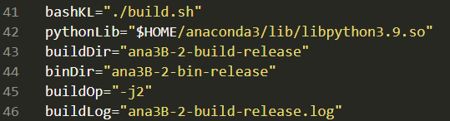
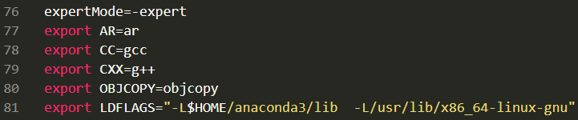
3. Details of Scenario=Mint19-B
Pros | Can use the latest Python and Ruby in Anacodna3
Cons | There are some library version mismatches/skews (mainly libstdc++ & libGL) to resolve somehow Need to run KLayout’s “build.sh” in the expert mode after surveying
Key Parameters
Expert Mode Parameters
Command Line
Detailed Steps and Wrapper Bash
ana3B-1-steps.txt (go through this file first)
ana3B-2-steps.txt (this file next)

Slide 6
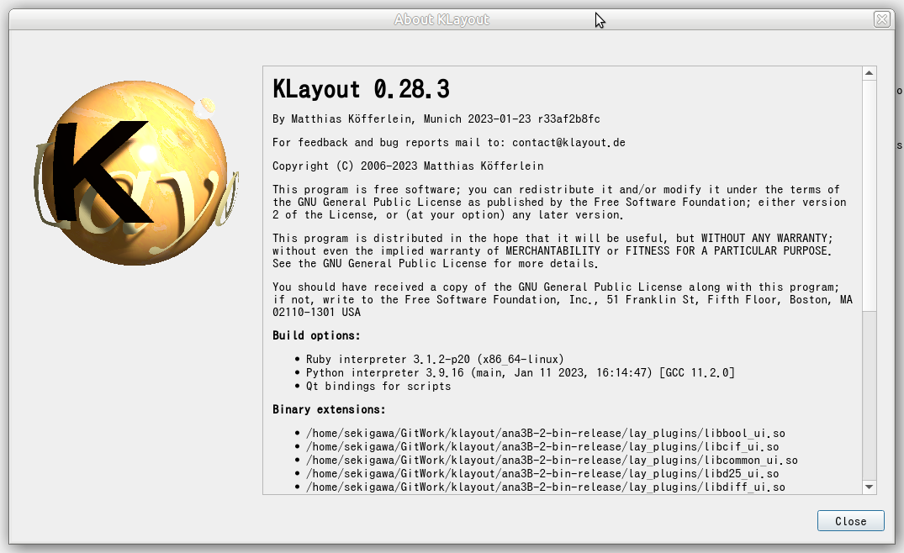
3. Details of Scenario=Mint19-B

Slide 7
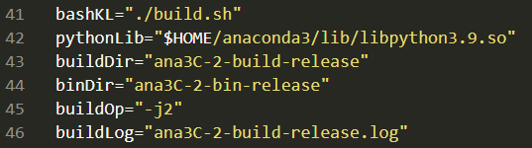
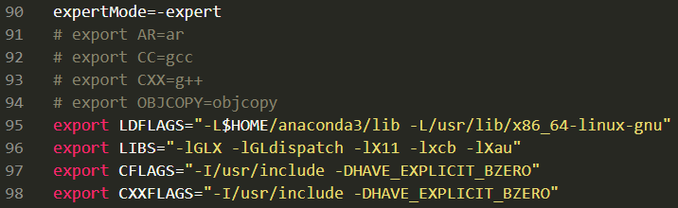
4. Details of Scenario=Mint19-C
dishearteningly troublesome!
Pros | Can use the latest Python and Ruby in Anacodna3
Cons | There are many library version mismatches/skews (libstdc++, libGL, and more) to resolve somehow Need to run KLayout’s “build.sh” in the expert mode after several stages of surveying
Key Parameters
Expert Mode Parameters
Command Line
Detailed Steps and Wrapper Bash
ana3C-1-steps.txt (go through this file first)
ana3C-2-steps.txt (this file next)

Slide 8
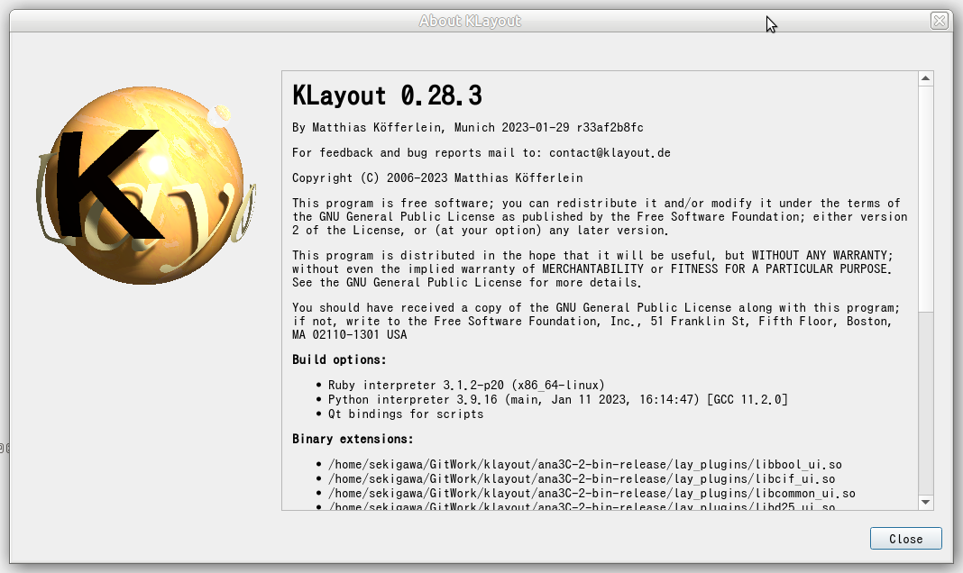
4. Details of Scenario=Mint19-C

Slide 9
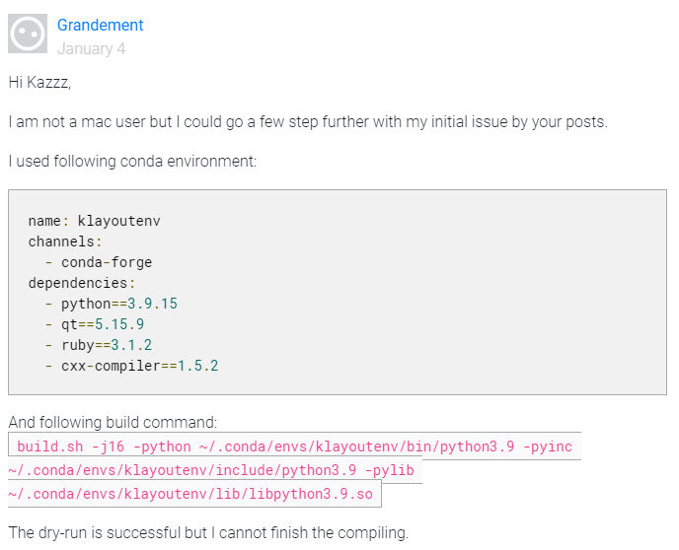
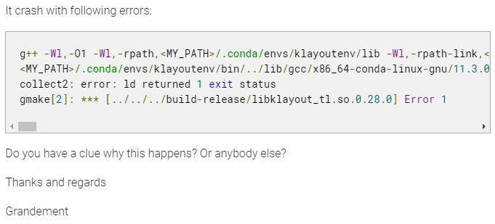

5. Suggestions
It looks like better to avoid using Anaconda’s gcc if not a MUST
After generating Makefiles, we can manually edit them.
Then, `make` experiments to determine what parameters are to be added/modified.
“-dry-run” only generates Makefiles

